Slide 1
Capstone Project
Mobile Price Range Prediction
By Dhanraj A Tiwari

Slide 2
Deriving insights for the Mobile Price Range Prediction
1. Understanding the dataset with all rows and columns that what the dataset is trying to say.
2. After checking the dataset we get to know that we don’t have any null values and also our dataset is
cleaned.
3. And then we have to do training and testing of our model.
4. And at last we have to check the accuracy by using some classification techniques.

Slide 3
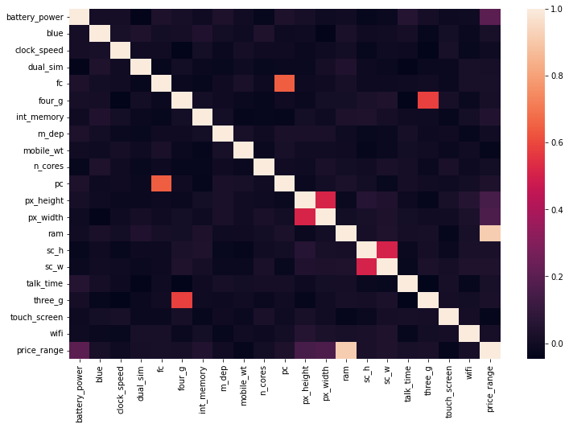
Exploratory Data Analysis

Slide 4
1. Checking for correlation between features and label.
2. Here we saw that we have good correlation with battery_power, px_height, px_width.
3. And also having ram column which is having very good coorelation .

Slide 5
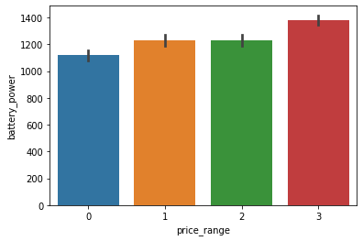
Comparing battery_power with price_range using barplot

Slide 6
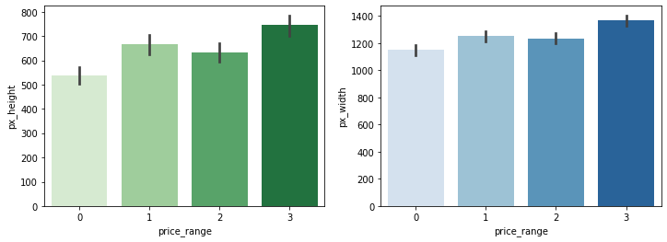
Comparing px_height & px_width with price_range using barplot

Slide 7
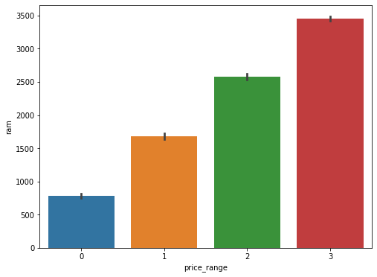
Comparing ram with price_range using barplot

Slide 8
1. After doing eda i am doing an training and testing of the model .
2. And then using multiple classification technique to build my model and to predict the accuracy.
i.) Naive Bayes Classifier
ii.) KNN Algorithm
iii.) Support Vector Machine

Slide 9
Thank You

